Slide 1


INTELLIGENT PREDICTIVE MODELLING
USING BIG DATA
FOR GENERIC DRUG SELECTION
THESIS SUBMITTED TO
SAVITRIBAI PHULE PUNE UNIVERSITY
For
AWARD OF DEGREE OF
Doctor of Philosophy(Ph.D.)
In the
Faculty of Computer Management
By
Netraja C. Mulay (Ph.D. Student)
Under the Guidance of
Dr. Maithil Arjunwadkar (Ph.D. Research Guide)
Research Center:
Progressive Education Society’s
Modern Institute of Business Studies, Pune Maharashtra

Slide 2

Agenda
Introduction
Traditional Drug selection Process
Literature Review
Aim and Objectives
Design
Model Diagram
Flowchart
Data Collection
Input->Process->Output
Data Visualization
Conclusion
Publications
Limitations
Future Research
References

Slide 3






Introduction
  Stands 3rd worldwide in production and
  14th in terms of Value
  Types of Drug
  Drug
  Innovator Drugs
  Generic Drugs
  DP(Formulation)
  API
Drug Product(Formulation)
Tablets
Capsules
Injections(Vial)
Syrup
Liquid
Ointments
Powder
Gel
  Drug Content
Active Pharmaceutical Ingredient
Raw material for DP
Variety of states, such as crystals and powders
E.g. In Crocin tablet Paracetamol substance act as API
API for relief of pain is included in painkiller

Slide 4
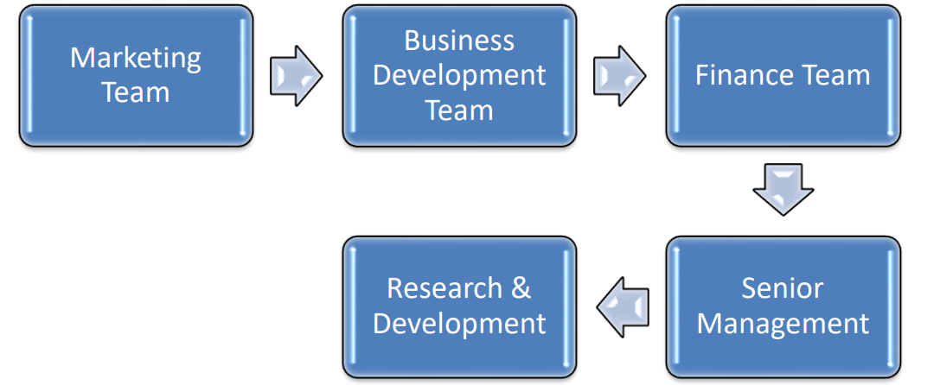
Traditional Drug Selection Process

Slide 5
Literature Review
Pharmaceutical Drug Selection process
Big Data Tools & Technologies
Prediction Modelling Using Machine Learning Algorithms
Data Visualization and Knowledge Interpretation Tools
Reviewed 100+
Research Literature
Books & Magazines
Journals & Conference Proceedings
Dissertations & Thesis
Websites

Slide 6

Objectives
Aim & Objectives
AIM
The primary aim of the proposed model is to utilize effectively big data analytical techniques and to develop an Intelligent Predictive model which will be acting as a guideline for the pharmaceutical product selection.
1
2
3
4
To carry out review of domain and technology required for big data analytics
  To capture the data
  required for generic
  drug selection from
  various resources
  To design intelligent
  predictive model for right
  generic drug selection
  in pharmaceutical industry.
  To implement the
  designed model using big
  data analytics

Slide 7
Design
Implement with Dashboard
Test Model
Train Model
Model Selection
EDA
Data Preprocessing
Data Collection
Define Objectives
Ph.D. Viva Voce Presentation Wednesday, July 18, 2025
7

Slide 8
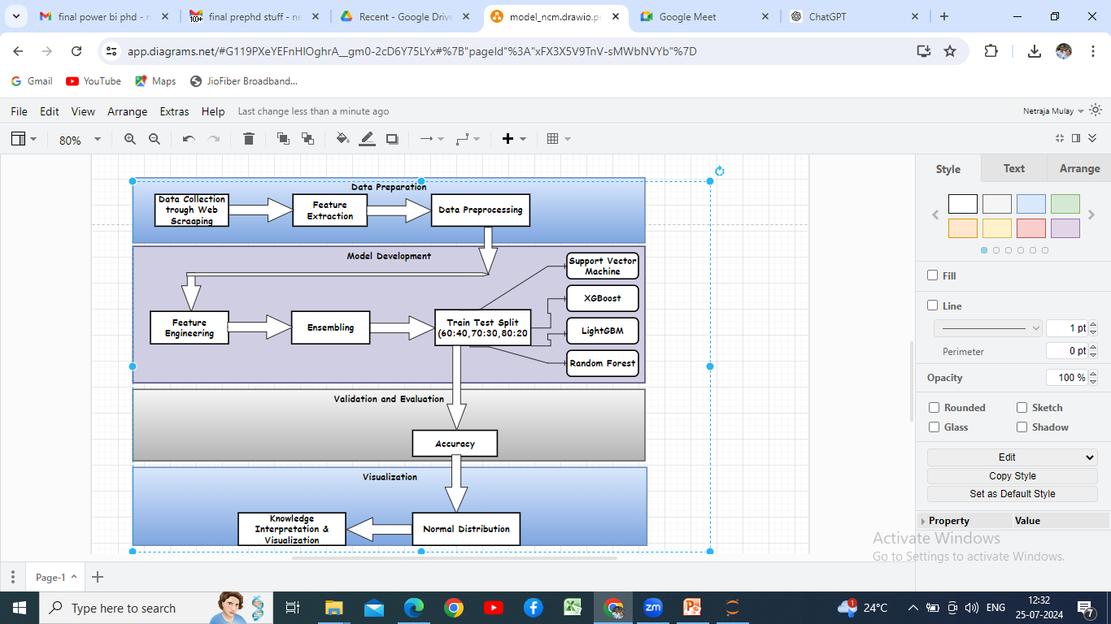
Model Diagram
Ph.D. Viva Voce Presentation Wednesday, July 18, 2025
8

Slide 9
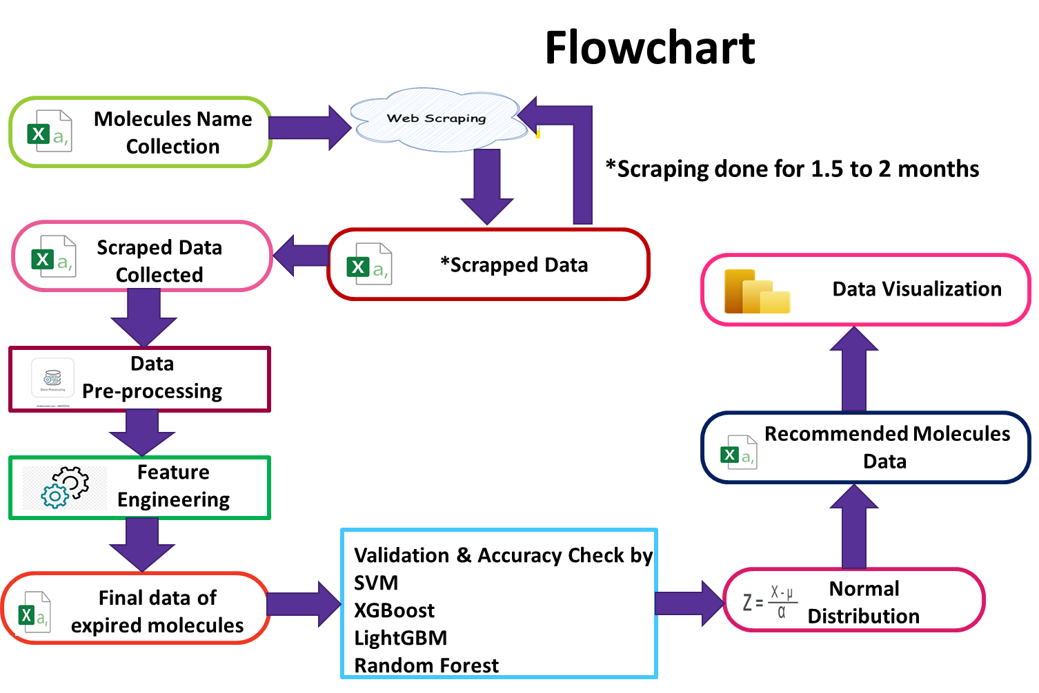
25,287
3,19,795
6,407
2,72,741
Ph.D. Viva Voce Presentation Wednesday, July 18, 2025
9

Slide 10


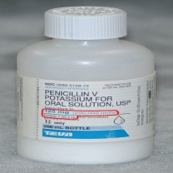
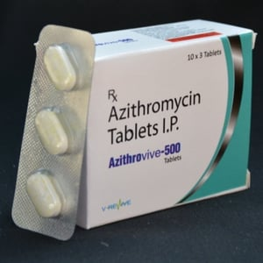


Data Collection
To take a decision of right generic drug selection data collected online by considering following parameters.
Most of the data available online through orange book
Orange Book: Approved Drug Products with Therapeutic Equivalence Evaluations (fda.gov)
  Applicant Holder
  Sector
https://www.drugs.com/dosage/azithromycin.html
Notification and Report on National List of Essential Medicines, 2022.pdf (mohfw.gov.in)
  Dosage
  Strength
https://www.pdfhunter.com/wp-content/uploads/2021/08/Jan-Aushadhi-Medicine-List-2021-PDF.pdf
  Approval Date
  Route
  Active Ingredient
https://purplebooksearch.fda.gov/downloads
https://www.accessdata.fda.gov/scripts/cder/daf/index.cfm?event=browseByLetter.page&productLetter=A&ai=0

Slide 11
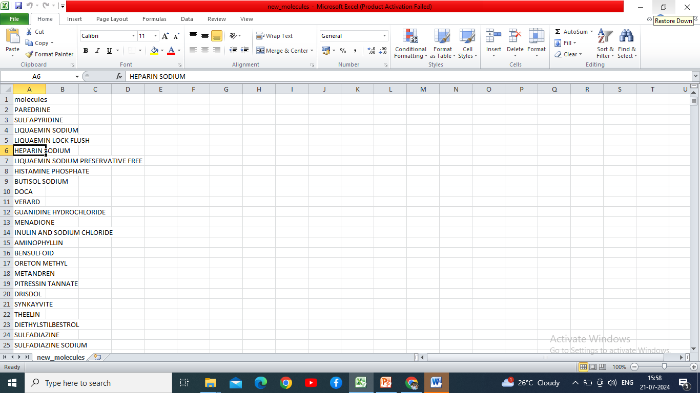
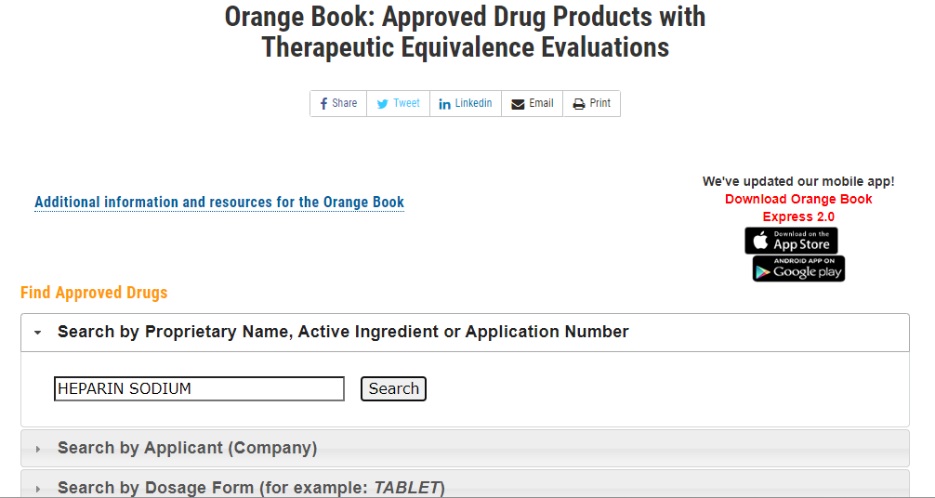
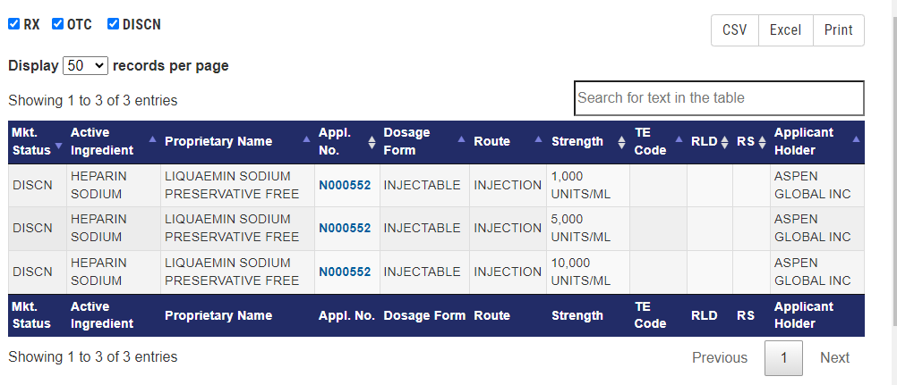
Input->Process->Output
Input

Slide 12
Continue…
combined_results.csv

Slide 13
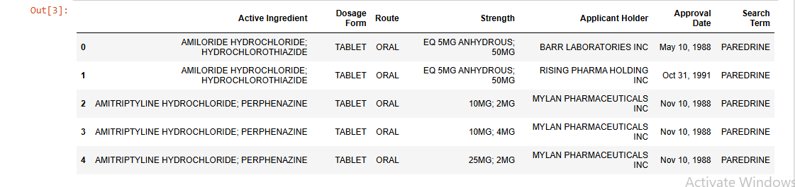
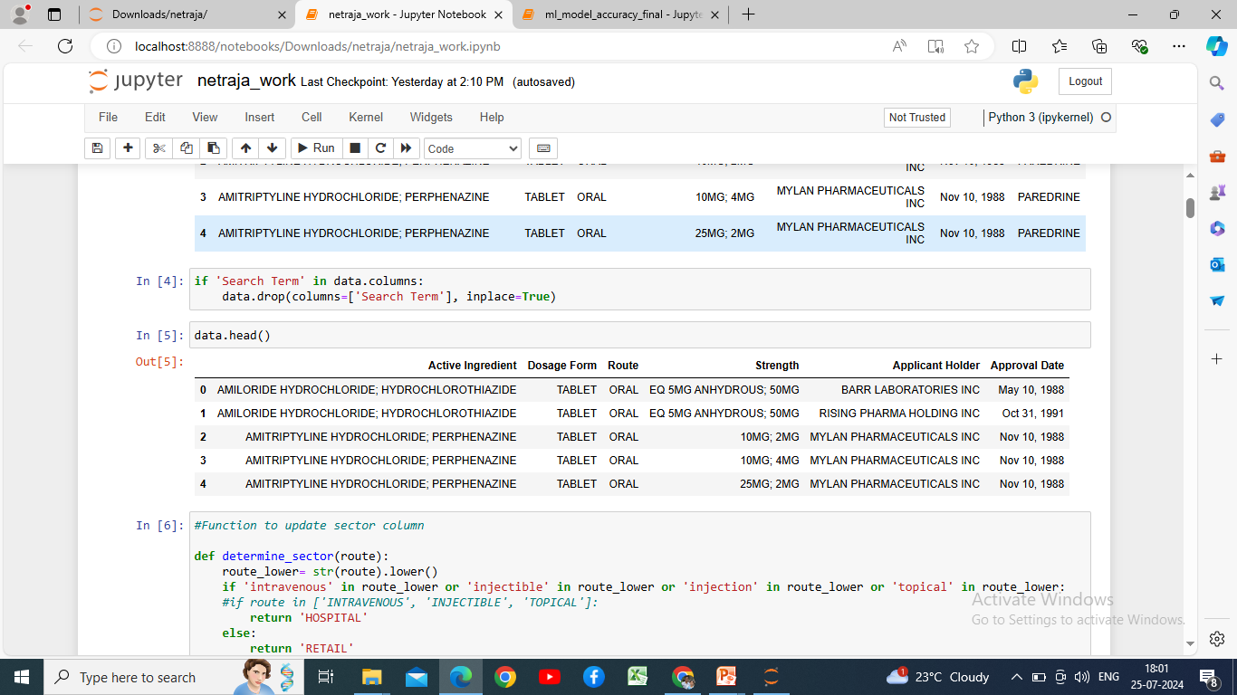
Process
Data Preprocessing- Removal of Noisy, Duplicate, Missing ,Null Data and dropping of columns
final_data.csv

Slide 14
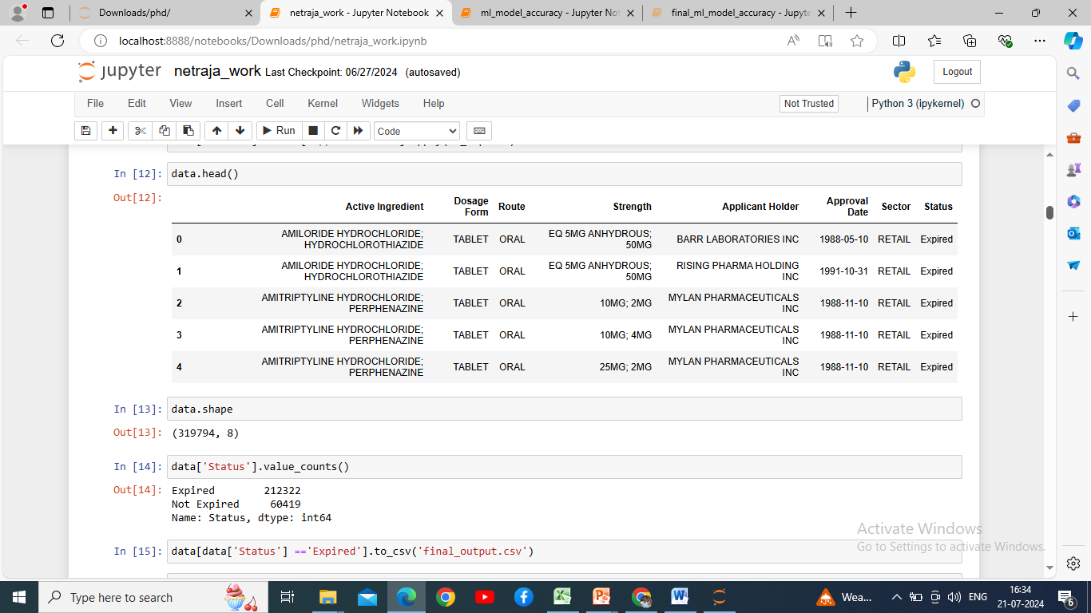
Continue…
Feature Engineering-Addition of new column Sector ,Performing manipulation on column

Slide 15
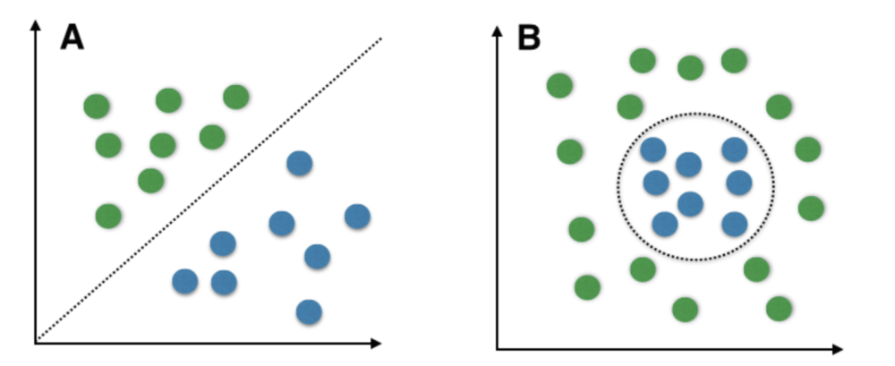
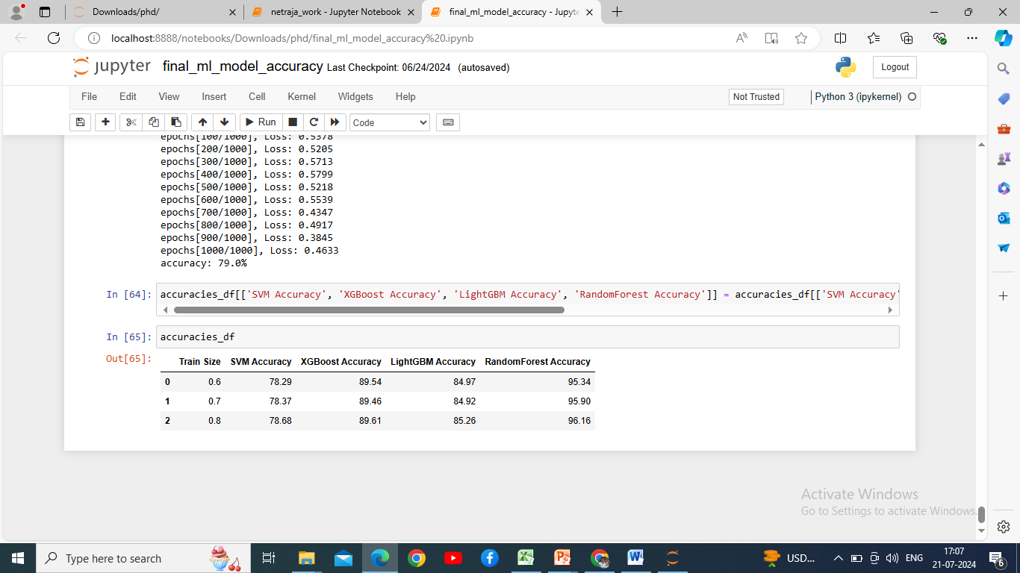
Continue…
Support Vector Machine (SVM)
Ideal For- Binary classification
Definition-Supervised machine learning algorithm for classification
The main idea behind SVM is to find the optimal boundary (called a hyper plane) that best separates the data points of different classes.
Output:

Slide 16
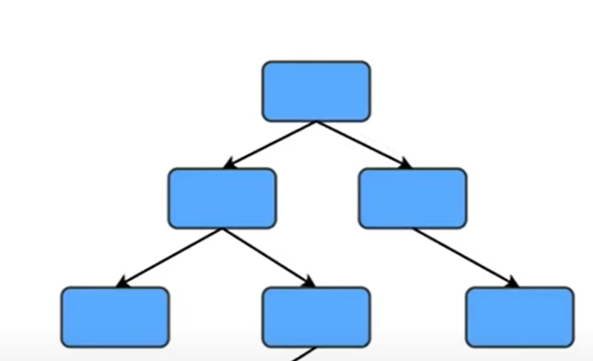
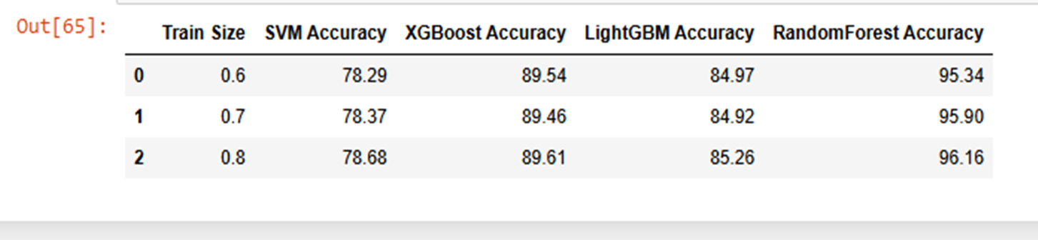

Continue…
eXtreme Gradient Boosting(XGBoost)
Ideal For- Classification, large dataset
Definition-A powerful and efficient open-source gradient boosting algorithm designed for speed and performance. Widely used for structured/tabular data.
The main idea behind XGBoost is it builds an ensemble of trees that passed features to trained trees each tree returns prediction. Add up of all tress to generate final score.
Output:

Slide 17
Continue…
Light GBM (Gradient Boosting Method)
Ideal For- Large datasets, high performance, low memory usage high accuracy
Definition: Fast, distributed, and efficient gradient boosting framework that uses tree-based learning algorithms to solve classification problem on large datasets.
The main idea behind using Light GBM in my model because it can directly handles categorical data without one hot encoding.
Output:

Slide 18
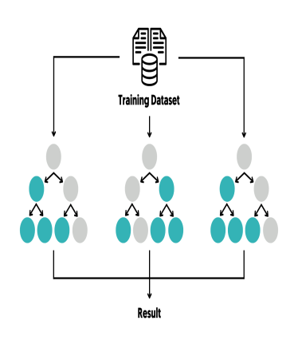
Continue…
Random Forest
Ideal For- Handling many features , reduces over fitting
Definition: It is an ensemble learning method that combines the predictions of many decision trees, each built on a random subset of the data and features, to improve accuracy and reduce over fitting.
The main idea behind using this algorithm in my research because it is robust and given the highest accuracy with the help of voting classifier.
Output:

Slide 19
Output
Label Encoding, Validations and finding accuracies through ML Models

Slide 20
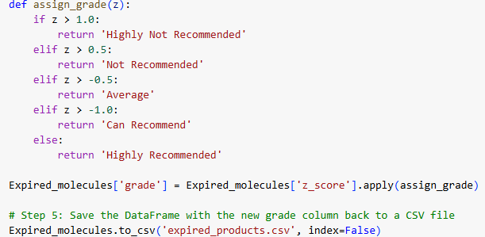
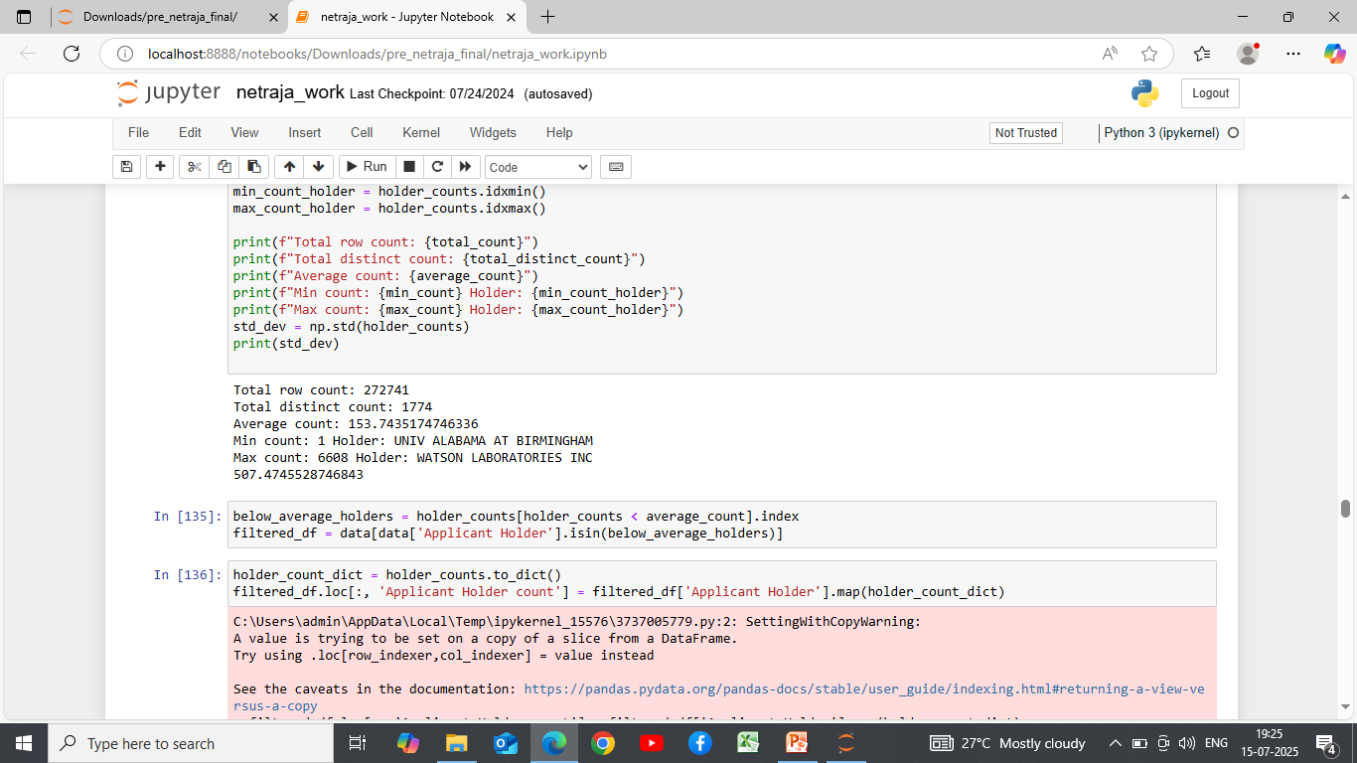
Continue…
Z=X-µ/σ
X-Data Point
µ- Average Applicant Holder count
σ- Standard Deviation
If z-score>1.0
Player count:167 to 123
Grade: Highly Not Recommended
If z-score> 0.5
Player count:122 to 99
Grade: Not Recommended
If z-score>-0.5
Player count:98 to 52
Grade: Average
If z-score>-1.0
Player count:51 to 28
Grade: Can Recommend
If z-score<-1.0
Player count:27 to 01
Grade: Highly Recommended

Slide 21
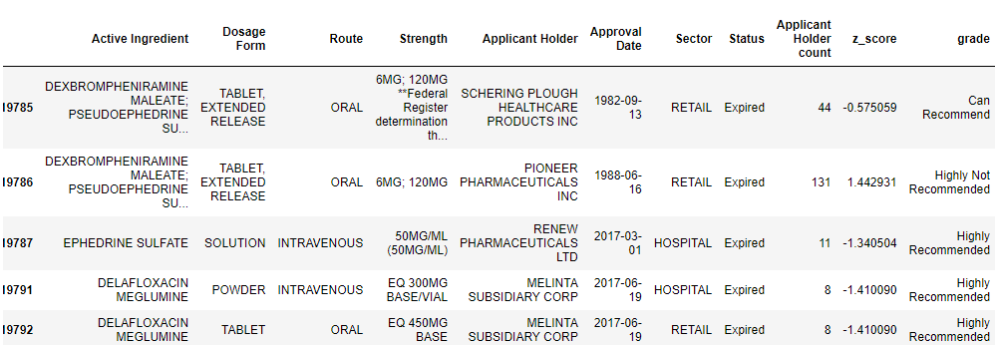
Continue…
Apply Normal Distribution as a key parameter in Decision Making

Slide 22
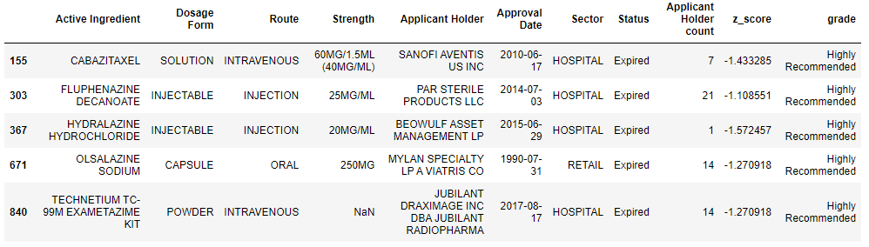
Continue…
Expired_molecule.csv

Slide 23
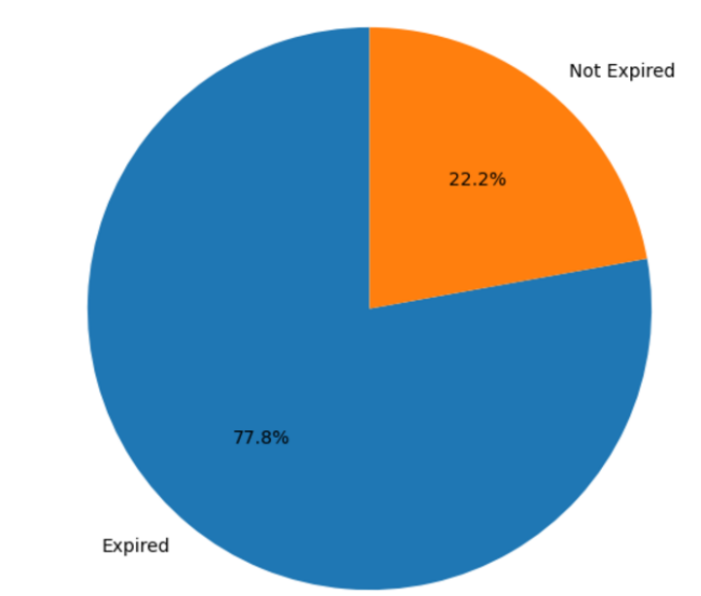
Data Visualization-Pre Visualization
Expired and Not expired molecules

Slide 24
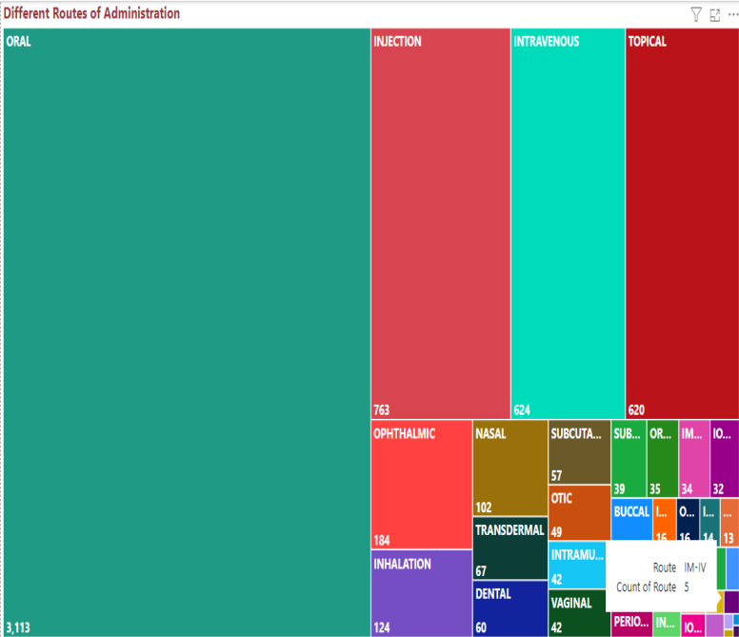
Different Routes of Administration of a molecule

Slide 25
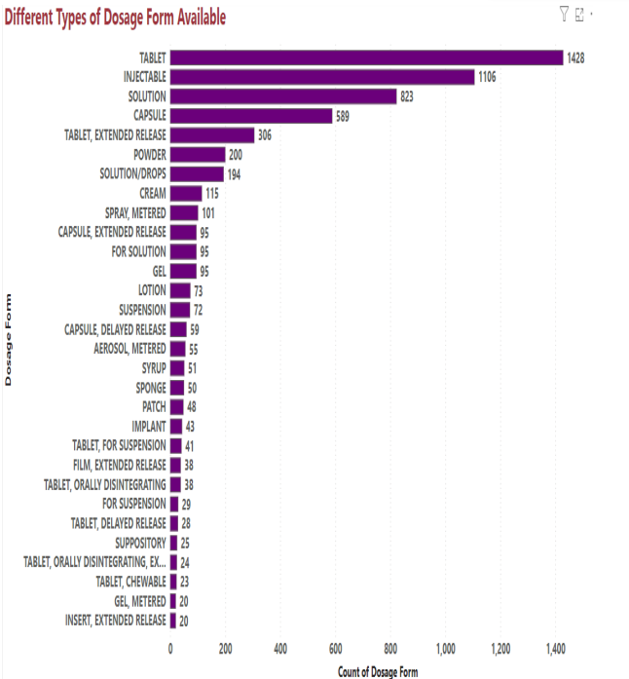
Different Dosage forms available

Slide 26
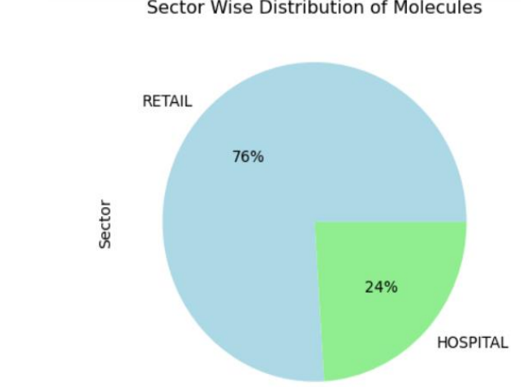
Sector Wise Distribution of Molecules

Slide 27
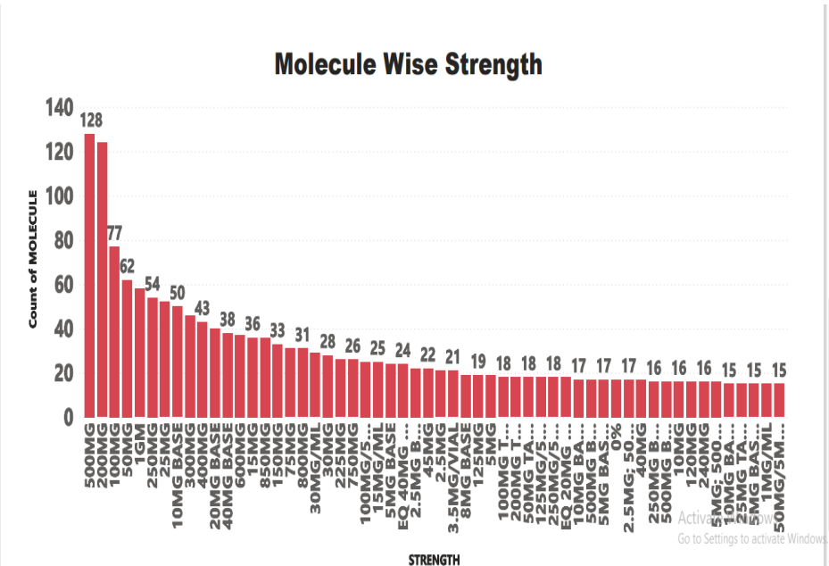
Molecule Wise strengths available

Slide 28
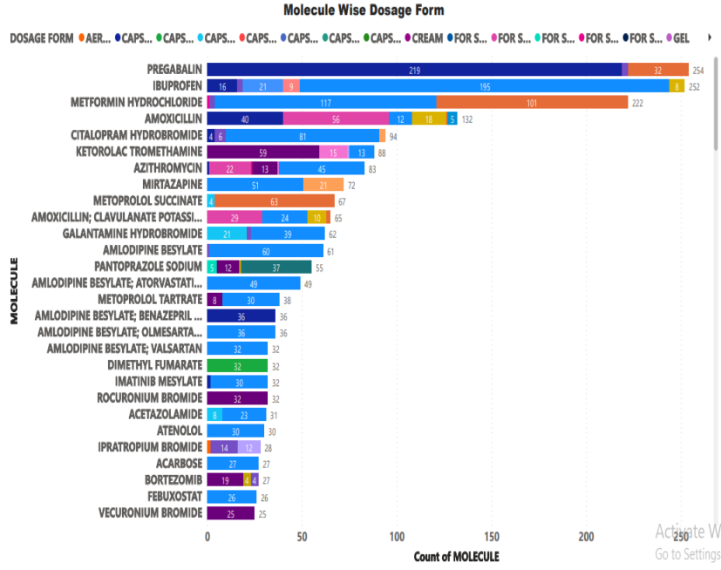
Molecule Wise Dosage Form

Slide 29
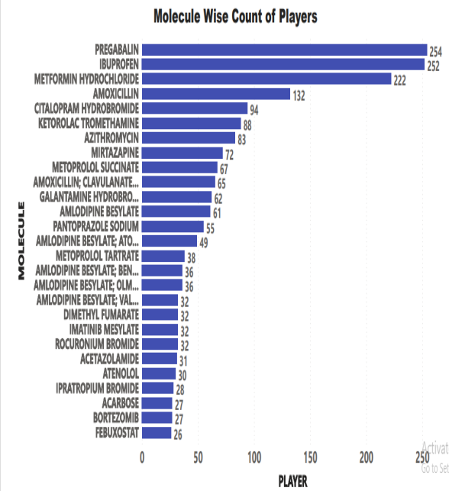
Molecule Wise Count of Players

Slide 30
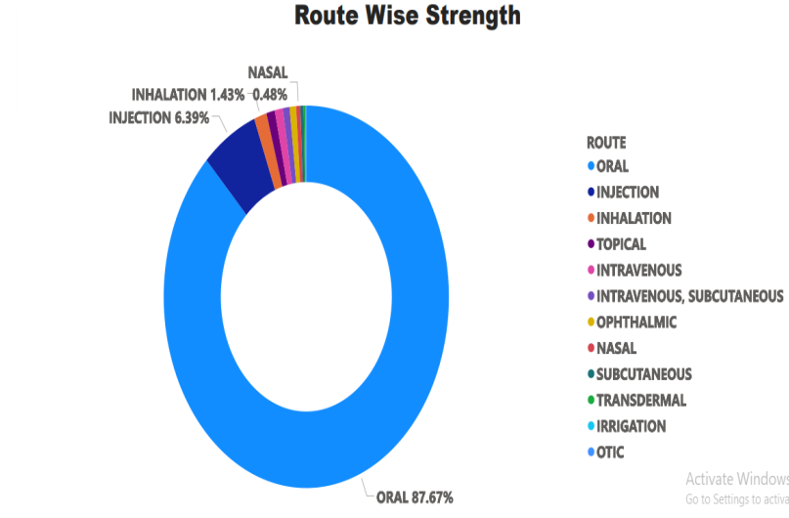
Route Wise Strength

Slide 31
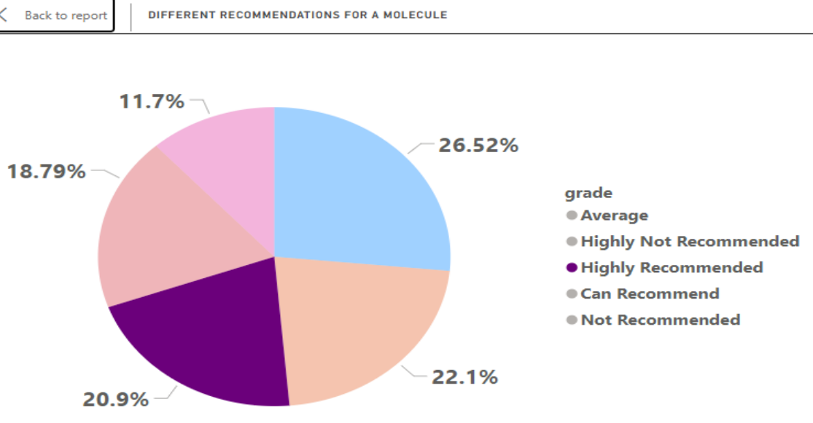
Different Recommendations generated for a molecule

Slide 32
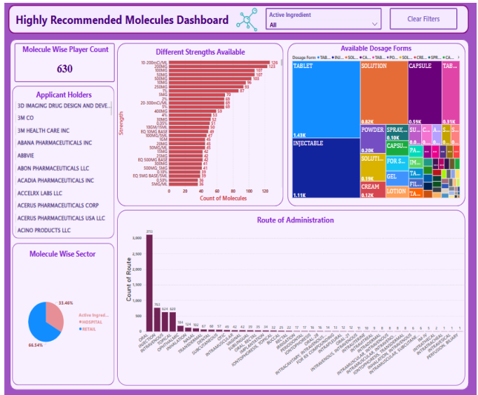
Post Visualization
Highly Recommended Molecules Dashboard

Slide 33
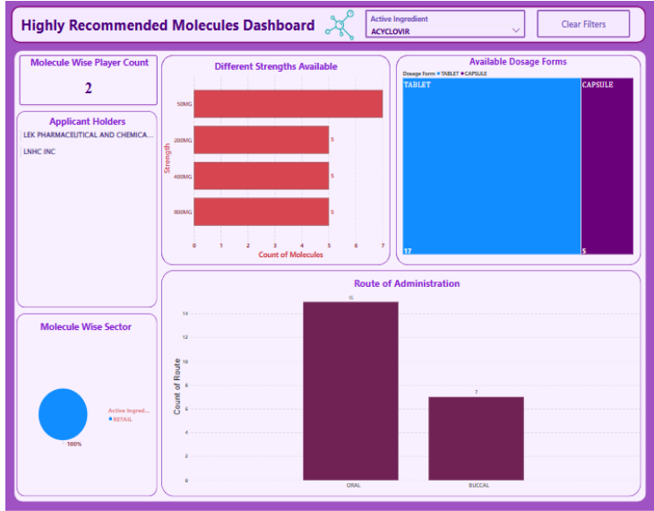
Molecule with less players and applicable sector is retail

Slide 34
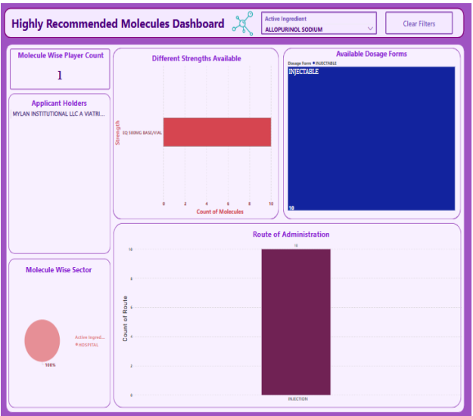
A Molecule with less Player and Applicable Sector is Hospital Only

Slide 35
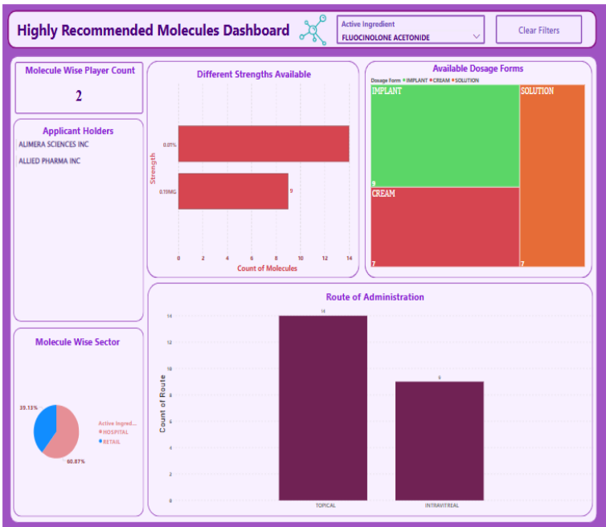
A molecule with only two players and applicable sector is Hospital and Retail

Slide 36
Conclusion
The model takes input as molecule names and extracts relevant features using the Selenium web scraping technique
The expired molecules were taken into consideration and are stored.
Exploratory Data Analysis (EDA) was carried out to clean and preprocess data.
Feature engineering was performed to manipulate features, such as the approval date, and to create new features based on existing ones e.g. a new feature called “Sector” was derived from the “Route” feature
Using various Python functions, the model was capable of determining the Applicant Holder-wise count of molecules to establish a threshold value for each Applicant Holder.
Multiple machine learning algorithms, including Support Vector Machine (SVM),XGBoost, LightGBM, and Random Forest, were employed to enhance the performance and robustness of the developed model. The dataset was trained and tested using different training and testing splits (60:40, 70:30, and 80:20) to improve the models performance, accuracy, and reliability. The model demonstrated optimal performance with the 80:20 split, achieving an accuracy of 96.16%
The data was validated using the K-fold cross-validation technique.
Through statistical method of a normal distribution z-score values were generated to classify a molecule into categories such as Highly Recommended, Can Recommend, Average Recommended, Not Recommended, Highly Not Recommended.
The model extracts and presents all Highly Recommended molecules, serving as a critical tool for decision-makers in the selection process of the appropriate molecule.
The model utilizes Power BI as an effective tool for representing pre visualization as well as post visualizations of the Highly Recommended molecules data.

Slide 37
Publications
Intelligent Predictive Modeling Using Big Data for Drug Selection in Pharmaceutical Industry
(Published & Presented)
Details of the first paper
Description of the first paper
Presented and Published above paper
Scopus Publication Link-
https://www.turcomat.org/index.php/turkbilmat/article/view/8087/6327
Presented this paper in International conference IC2TMA at IMCC
Innovative and Generic drugs
DP and API
Drug selection methodology
4V’s of Big Data
Big Data fro drug selection
Strength of predictive analytics
Big Data Analytical Tools like Hadoop,Python,R, etc.

Slide 38
Continue…
Role of Big Data Analysis in Pharmaceutical Product Selection (Published)
Details of the second paper
Description of the second paper
https://drive.google.com/file/d/12EgwmydElVHAReSiV8cL4eCcGRl4z8mE/view
Published this paper in Gradiva Review Journal
Big Data Analytics
Types of Big Data Analytics
Data Analysis Steps

Slide 39
Continue…
Study of big data analytical open source tools: A roadmap for pharmaceutical generic drug selection
(Published & Presented)
Details of the third paper
Description of the third paper
Presented and published this paper online in International Conference on Recent Trends and Advancement in Science, Technology, Commerce and Management at Sanjivani College of Engineering, Kopergoan in association with Jorden River University USA .
UGC publication Link
file:///E:/Netraja%20Data/D/Ph.%20D.%20data%20NCM/six%20monthly%20report%202/third%20research%20paper%20e-book.pdf
Introduction
Importance of Data Analytics in Pharmaceutical Companies for right selection of product
Big Data Analytical Tools

Slide 40
Continue…
Why Big Data for Pharmaceutical Product Selection:
A Review
Details of the fourth paper
Description of the fourth paper
Published this paper in UGC Care Journal named Fuzzy Systems and Soft Computing .
Paper Publication Link:
PAPER(19) (1).pdf
Summary of Research Papers
As large volume of pharmaceutical generic drug data cannot be managed by traditional databases. So this paper focuses on how 4 V’s of big data i.e. Volume, Variety, Velocity
Veracity will fit into parameters of generic drug selection.
Sr. No. | Name | Year
1. | Intelligent Predictive Modeling Using Big Data for Drug Selection in Pharmaceutical Industry | 2021
2. | Role of Big Data Analysis in Pharmaceutical Product Selection | 2022
3. | Study of big data analytical open source tools: A roadmap for pharmaceutical generic drug selection | 2023
4. | Why Big Data for Pharmaceutical Product Selection: A Review | 2024

Slide 41
Limitations
Limited Data Availability - The other factors like Value , Volume, Cost Of Goods Sold(COGS),Average Selling Prize (ASP),Return On Investment(ROI),Gross Margin, Sales Data is not considered by this model because of unavailability of this data online.

Slide 42
Future Research
The model was unable to collect features related to value, volume, Cost of Goods Sold (COGS), Average Selling Price (ASP), Return on Investment (ROI), Gross Margin, and Sales Data. This is because such information is confidential within the pharmaceutical industry and is not typically made available on public platforms. However, if pharmaceutical companies had access to this data, it could significantly enhance decision-making for generic drugs.
Beyond the pharmaceutical sector, this prediction model can prove to be highly valuable for a wide range of industries seeking to make data-driven decisions regarding product selection. By leveraging the model's capabilities, businesses in sectors such as retail, manufacturing, and consumer goods can gain valuable insights into market trends, consumer preferences, and product performance, ultimately optimizing their product strategies and improving overall decision- making processes.

Slide 43
References
[1] Jainul Fathima,Murugaboopathi Gurusamy,”A Novel Customized Big Data Analytics Framework for Drug Discovery”,vol.7,Issue 1 & 2,January 2018.
[2] Farzana Elahi, Afia Muqtadir, Shahriyar Anam &K. Mustafiz,” Pharmaceutical Product Selection: Application of AHP” International Journal of Business and Management; Vol. 12 ISSN 1833-3850 Canadian Center of Science and Education
[3] Preetanshu Pande,R.Bharadwaj,” predictive Modeling of Pharmaceutical unit operations”,ResearchGate,October 2016.
[4] Donatella Verbanac,”Predictive Methods as a powerful tool in Drug Discovery.”ResearchGate,January 2010.
[5] David Asamoah,Jonathan Annan,”AHP Approach for Supplier Evaluation and Selection in a Pharmaceutical Manufacturing Firm in Ghana”,ResearchGate,May 2012
[6] Peter Tormay,”Big Data in Pharmaceutical R&D: Creating a SustainableR&D Engine”March 2015.
[7] Akshansh Sharma, Firoj Khan, Deepak Sharma, Dr. Sunil Gupta,” Python: The Programming Language of Future” Volume 6Issue 12, ISSN: 2349-6002,May 2020

Slide 44
Continue…
[8] Sunil Kumar,Maninder Singh,”Big Data Analytics for Healthcare Industry:Impact,Applications and tools”,Volume 2,ISSN:2096-0654
[9] Nada Elgendy & Ahmed Elragal,”Big Data Analytics: A Literature Review Paper” Research Gate.
[10] Andrej Trnka,”BIG DATA ANALYSIS”, European Journal of Science and Theology, October 2014, Vol.10, Suppl.1, 143-148
[11] Zhaohao Sun,Yanxia Huo, “The Spectrum of Big Data Analytics” Journal of Computer Information Systems, Feb 2019
[12] D. P. Acharjya, Kauser Ahmed P,” A Survey on Big Data Analytics: Challenges, Open Research Issues and Tools”, (IJACSA) International Journal of Advanced Computer Science and Applications, Vol. 7, No. 2, 2016
[13] Ilangovan Pandian,Meena Krishnamoorthy,Meenalaxmi Abinaya,”A Comparative Study On Three Big Data Anaytics Tools”,IJASRM,ISSN:2455-6378.
[14] J. Vijayalakshmi, Dr. E. Ramraj,”Comparative Study of Big Data Analytical Tools”, International Journal of Pure and Applied Mathematics, Volume 119, ISSN: 1311-8080
[15] Wes McKinney,”Pandas: a Foundational Python Library for Data Analysis and Statistics” Jan 2011,Research Gate

Slide 45
Thank you

